Slide 1
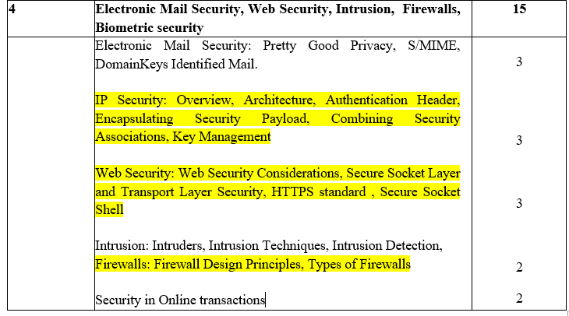

Slide 2
Attacks
Leaking of Valuable and confidential data in the corporate networks
great danger of outside elements (worms/viruses) entering a corporate netwrok to create havoc
N e t w o r k B a c k b o n e
Inside information can leak out from here
Router
To Internet
Outside dangers can come in from here
Corporate network

Slide 3
Network Threats
Mechanisms required to ensure that the inside information remains inside and also prevents the outsider attackers from entering inside a corporate network
Encryption does not work when outsiders break inside a corporate network
Better schemes are desired to achieve protection form outsider attacks
Firewalls

Slide 4
Firewall
Guards a corporate network by standing between the network and the outside world
Special type of router
Controls transmission between internal and external networks
Decides what to allow/disallow

Slide 5
Firewall Concept
N e t w o r k B a c k b o n e
To Internet
Corporate network
Firewall

Slide 6
Characteristics
All traffic fro inside to outside and vice versa must pass through the firewall
All access to the local network must first be physically blocked and access only via the firewall should be permitted
Only the traffic authorized as per the local security policy should be allowed to pass through
The firewall itself must be strong enough so as to render attacks on it useless

Slide 7
Firewall Types
Firewalls
Packet Filters
Application Gateways

Slide 8
Packet Filters
Applies a set of rules to each packet and based on the outcome decides to either forward or discard the packet.
Called the screening router or screening filter
Implemented using a router
Configured to filter packets going in either direction
Filtering rules are based
IP/TCP headers
Source and destination IP addresses
Port numbers

Slide 9
Packet Filter
Internet
Internal (Private) Network
Packet filter
Protected zone

Slide 10
Packet Filter Operation
Outgoing packets
Incoming packets
Receive each packet.
Apply rules.
If no rules, apply default rules.

Slide 11
Functions
Receive each packet as it arrives
Pass the packet through a set of rules
Decides whether to accept or discard the packet of the packet.
If no match with any of the rules take the default action
Discard all the packets or accept all the packets
Advantage
Simplicity
User need not be aware of the packet filter
Disadvantages
Difficulty in setting of the rules
Lack of support for authentication

Slide 12
Attacks
IP address Spoofing
Intruder outside the corporate network can attempt to send a packet towards the internal corporate network with the source IP address set to one of the IP addresses of the internal users
Source address: 178.29.10.91
178.29.10.89
Incoming packet
178.29.10.91
178.29.10.90
Packet filter
STOP!
••••
Internal network and the IP addresses of the hosts

Slide 13
Attacks(Contd)
Source routing attacks
Attacker can specify the route that a packet should take as it moves along the Internet
Attacker hopes that by specifying this options, the packet filter can be fooled bypass its normal checks
Discarding all the packets can thwart such an attack

Slide 14
Attacks(Contd)
Fragment attacks
IP packets pass through a variety of networks
All have a predefined maximum frame size(MTU)
this requires fragmentation
Attacker attempts to use this characteristic
Intentionally creates fragments of the original IP packet and sends them
The attacker feels that the packet filter can be fooled, if it only checks the first fragment and does not check the remaining ones
Attack can be foiled by discarding all the packets where the upper layer protocol type is TCP and the packet is fragmented

Slide 15
Advancements
Advanced type is the dynamic packet filter or the stateful packet filter
Allows the examination of packets based on the current state of the network
Adapts itself to the current exchange of information
Can specify a rule as
Allow incoming packets only if they are responses to the outgoing TCP packets that have gone through our network
Requires to maintain a list of all currently open connections and outgoing packet in order to deal with this rule

Slide 16
Application Gateways
Called a proxy server
Acts like a proxy or substitute
Decides about the flow of application level traffic
Working
Internal user contacts the application gateway using a TCP/P application(HTTP/TELNET)
Application gateway asks the user about the remote host which the user wants to set up a connection for actual communication
It also asks for the user id and password required to access the services of the application gateway
User provides this information to the application gateway

Slide 17
Application Gateway
HTTP
SMTP
FTP
TELNET
Inside connection
Outside connection
Application gateway

Slide 18
AG now access the remote host on behalf of the user and passes the packets of the user to the remote host
Circuit gate way
Performs some additional functions as compared to AG
Creates a new connection between itself and the remote host
User is not aware of this and thinks that there is a direct connection between itself the remote host
CG changes the source IP address in the packets form the end user’s IP address to its own
IP addresses of the computers of the internal users are hidden form the outside worlds
From here onwards the application gateway acts like a proxy of the actual end user and delivers packets from the user to the remote host and vice versa

Slide 19
Circuit Gateway
Source address = 178.29.10.90
Source address = 178.29.10.70
IP packet
IP packet
HTTP
SMTP
FTP
TELNET
Inside host
Outside host
Application gateway
IP address = 178.29.10.90
IP address = 178.29.10.70

Slide 20
Advantages
AG ‘s are more secure than packets filters
Rather than examining every packet against a number of rules we simply detect whether a user is allowed to work with TCP/IP application or not
Disadvantage
Overhead in terms of connections
There are actually two sets of connections
Between the end user and the application gateway
Between AG and the remote host
AG has to manage these two sets of connection and the traffic going between then
AG is also called bastion host
Is a key point in the security of the network

Slide 21
Application Gateway - Illusion
HTTP
SMTP
FTP
TELNET
Real connection
Real connection
Application gateway
User’s illusion
Internal host
External host

Slide 22
Firewall Configurations
Firewall Configurations
Screened host firewall,
Single-homed bastion
Screened host firewall,
Dual-homed bastion
Screened subnet firewall

Slide 23
Screened Host Firewall, Single-homed Bastion
Application gateway
Internet
HTTP
SMTP
FTP
TELNET
Packet filter
Internal network
••••

Slide 24
Screened Host Firewall, Single-homed Bastion
Firewall is set up consists of two parts
a packet filtering router and an application gateway
Purposes
Packet filter assures that the incoming traffic is allowed only if it is destined for the application gateway
Examines the destination address field of every incoming IP packet
It also ensures that the outgoing traffic is allowed only if it is originating from the application gateway by examining the source address field of every outgoing IP packet

Slide 25
Configuration increases the security of the network by performing checks at both packet and application levels
Giver more flexibility to network administrators to define more granular security policies
Disadvantage
Internal users are connected to the application gateway and the packet filter
Is the packet filter is attacked then the whole internal network is exposed to the attacker

Slide 26
Screened Host Firewall, Dual-homed Bastion
Internet
HTTP
SMTP
FTP
TELNET
Application gateway
Packet filter
Internal network
••••

Slide 27
Screened Host Firewall, Dual-homed Bastion
Configuration is an improvement over the earlier scheme
Direct connections between the internal hosts and the packet filter are avoided
The packet filter connects only to the application gateway, which in turn has a separate connection with the internal hosts
Even if the packet filter is successfully attacked only the application gateway is visible to the attacker
Internal hosts are protected

Slide 28
Screened Subnet Firewall
Offers highest security
Improvement over the previous scheme of
Two packet filters are used
One between internet and the application gateway,
Other between the application gateway and the internal network
Three levels of security

Slide 29
Screened Subnet Firewall
Internet
HTTP
SMTP
FTP
TELNET
Packet filter
Application gateway
Packet filter
Internal network
••••

Slide 30
Demilitarized Zone (DMZ)
Internet
••••
Internal private network
Firewall
Demilitarized Zone (DMZ)

Slide 31
Demilitarized Zone (DMZ)
Popular in firewall architecture
Firewalls are arranged to form a DMZ
DMZ required only if an organization has servers that it needs to make available to the outside world
There are at least three network interfaces
One connects to the internal private network
Second connects to the external public network (Internet)
Third connects to the public servers (forms the DMZ)

Slide 32
Advantage
The access to any service on the DMZ can be restricted
We can limit the traffic in/out of the DMZ network to the HTTP and HTTPS protocols
All other traffic can be filtered
Internal private network is no way directly connected to the DMZ
Even f the attacker can somehow manage to hack into the DMZ the internal private network is sfe and out of the reach of the attacker

